Slide 1


SMARTSHELFX
Smart Inventory Management System
Team Members:
Surabhi S
Mounika Daru
Janhavi Maurya
Kranthi Kumar
Mentor:Suramya Biswas

Slide 2




AGENDA
▪︎Introduction
▪︎Technology Stack
▪︎Modules Overview
▪︎Project Outcomes
▪︎Future Enhancement & Challenges
▪︎Conclusion

Slide 3
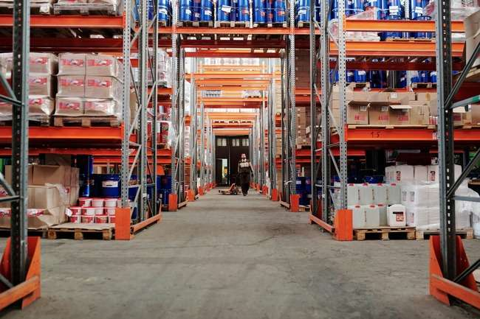
INTRODUCTION
• SmartShelfX is an intelligent inventory management system designed for efficient stock control.
• It enables seamless product management and real-time tracking of stock-in and stock-out operations.
• Provides secure, role-based access for Admin, Manager, and Vendor users.
• Delivers insightful reports and analytics to enhance decision-making and operational accuracy.

Slide 4

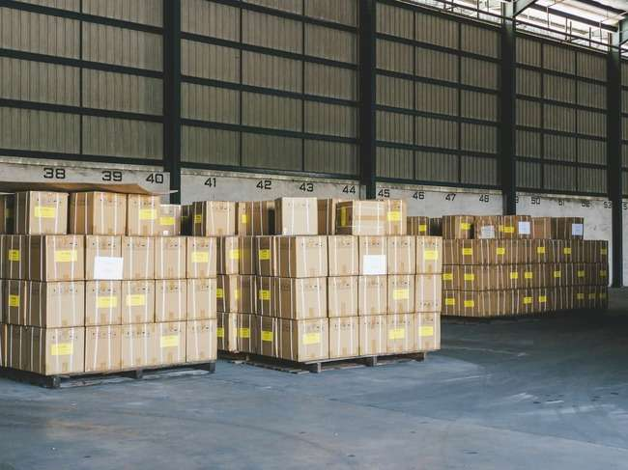
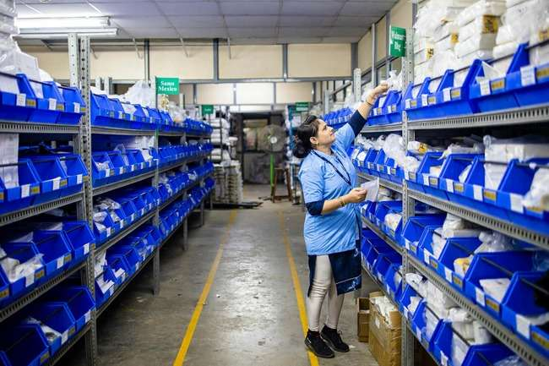








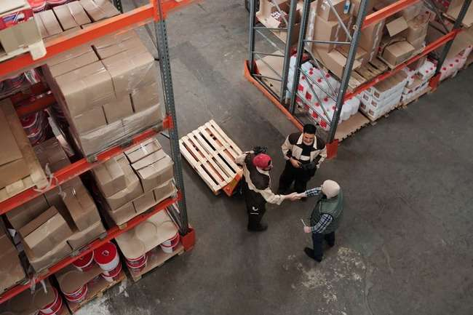
TECHNOLOGY STACK
React Js
SpringBoot
Spring Security
Spring Data JPA
Chart.js
MySql
Java
Eclipse

Slide 5
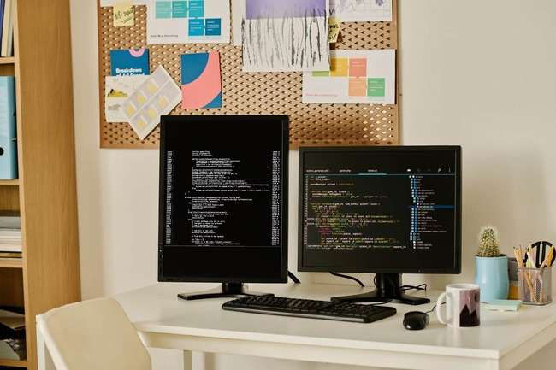

MODULES OVERVIEW
User & Role Management:
This module manages login and authentication with role-based access for Admin, Manager, and Vendor
Inventory Catalog & Product Management
It allows adding, updating, and organizing product details including Stock Keeping Unit(SKU), category, vendor, and reorder level.
Stock In / Stock Out Management
This module records incoming and outgoing stock to maintain accurate real-time inventory levels.
Analytics Dashboard
It provides visual insights through charts showing inventory trends, purchase and sales comparison, and demand analysis.

Slide 6



PROJECT OUTCOMES
• Achieved secure and role-based access control for Admin, Manager, and Vendor users.
• Enabled efficient product tracking and management using SKU, category, and reorder details.
• Improved real-time stock accuracy through automated updates on product availability and reorder status.
• Provided insightful analytics dashboards for better decision-making using visual reports and trends.

Slide 7



VISUALIZING SMARTSHELFX
A look at the user interface and the core components of the system.

Slide 8
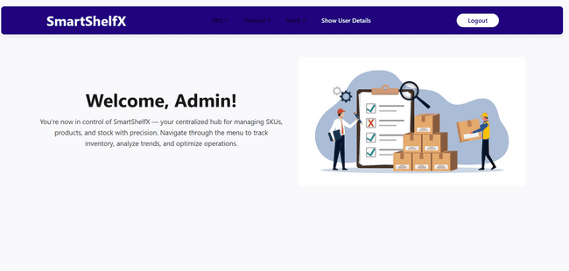
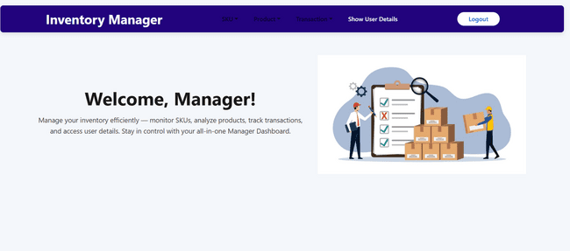
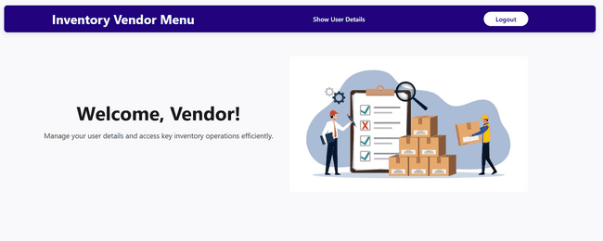
VISUALIZING SMARTSHELFX

Slide 9
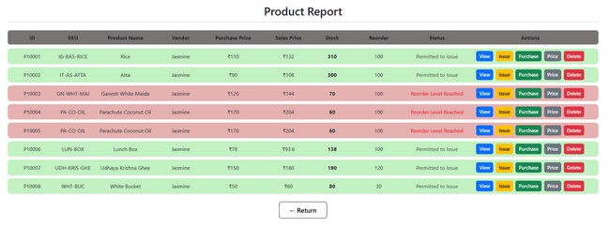
VISUALIZING SMARTSHELFX

Slide 10

EVOLUTION
Future Enhancement
Challenges
• Integrate AI for accurate demand forecasting and smart restocking decisions.
• Develop a mobile application for remote inventory access and management.
• Implement barcode and QR code scanning for faster product tracking.
• Ensuring accurate demand prediction and automation logic
• Managing secure role-based access and data protection
• Handling scalability for growing product and user data
• Maintaining consistent UI/UX across different roles

Slide 11



CONCLUSION
SmartShelfX enables efficient inventory management with timely product availability.
It supports warehouse and retail operations through better visibility and accuracy.
Its secure and scalable design allows future improvements as requirements grow.

Slide 12

THANK YOU

